Slide 1
This is the link to the youtube video of me presenting. Go to that because this ppt is very bare bones and is not meant to be independent.
https://www.youtube.com/watch?v=W2RVmhUaVGw

Slide 2
Final Part 2
By Hong Ming Gong

Slide 3
My portfolio
https://goodman599.github.io/dev109/Final%20portfolio/Pages/index.html

Slide 4
The features I’m proud of

Slide 5
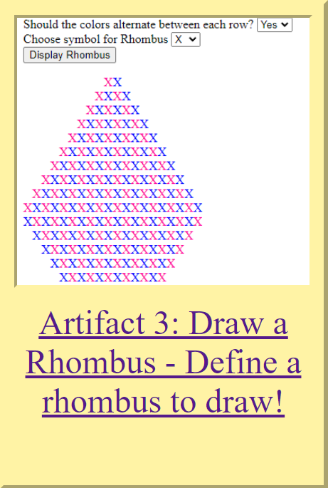
Artifact 4
Learned new ways how JavaScript can interact with forms
Added an extra feature that the professor appreciated
Didn’t follow the template already given

Slide 6
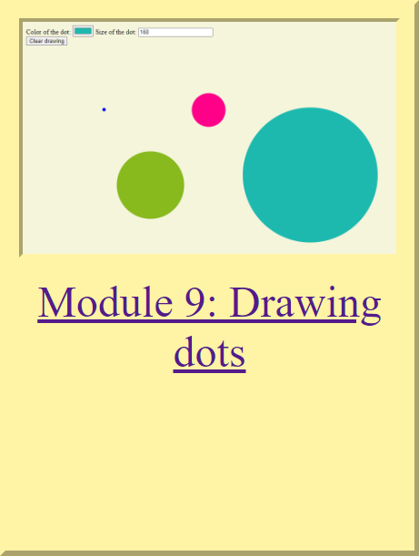
MODULE 9
I had a relatively good grasp of JavaScript despite having never used it before.
First module that really challenged me

Slide 7
The process
Followed the template
Tried to add colors and size
Properly understood PreventDefault();
Learned how JS can interact with the DOM

Slide 8
Takeaways

Slide 9
Positives
negatives
Learned the importance of staying up to date
Learned more about myself: I like to plan ahead
Learned the importance of accommodating everyone
I regret not taking more initiative
I realized I procrastinate a lot

